Slide 1
Creating the forensic community
Robert Green

Slide 2
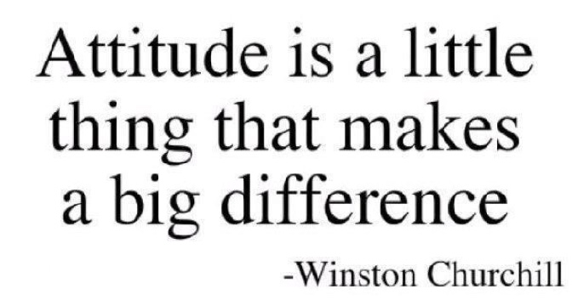
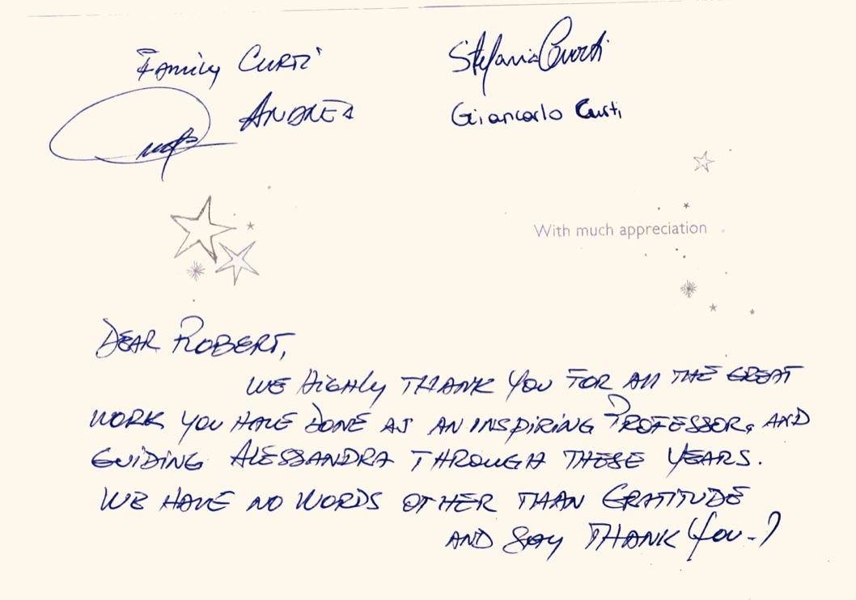
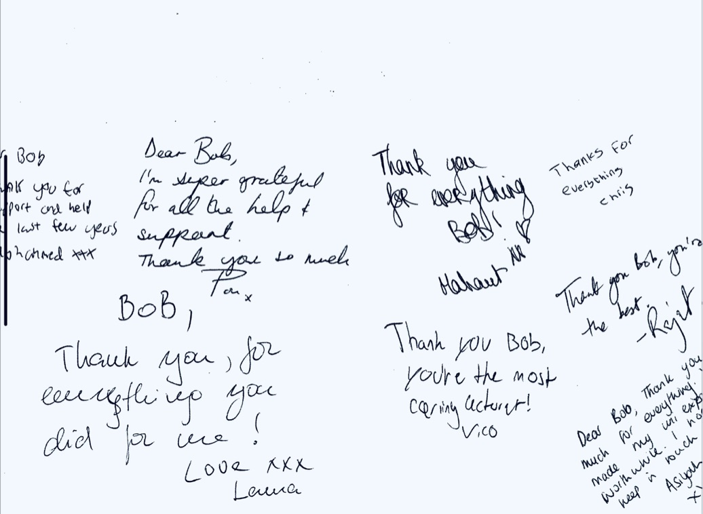
Disclaimer
These are just personal thoughts and activities I’ve initiated since dipping my toe into academia.
These ideas shouldn’t necessarily be taken to reflect the views of the school or the University of Kent. Does it work – dunno but maybe?

Slide 3
Where it all began
During my first full-time job in teaching after leaving the Home Office.
Some observations “… well there’s not much happening in forensic science is there” (Student). There was and is lots happening!
‘Article of the week’ (a weekly article from an academic journal or news item to students) – uptake variable.
Developed into a termly, monthly and now weekly newsletter to all forensic science students.
Yes – it takes me some time to do this now but helps keep regular contact (termly – monthly not so effective) and it gets me out of shopping ☺
Take a look at last weeks edition here (There are links to past issues on the back page). An typical issue from 2017 can be seen here
FB ‘chat group’ circulation of weekly news, circulation circa 200

Slide 4
How does this benefit
Gives a sense of belonging
Keeps us all up to date with latest news (curriculum lag – feedback from employers)
Inspiration by seeing success of others
Keeps in touch with alumni, friends, family, colleagues
Our students like the approach
Our faculty employment adviser notes “…a sense of community which is unrivalled in other academic schools is also evident and fostered by the work of the Forensic society and the extracurricular visits organised for students”.

Slide 5
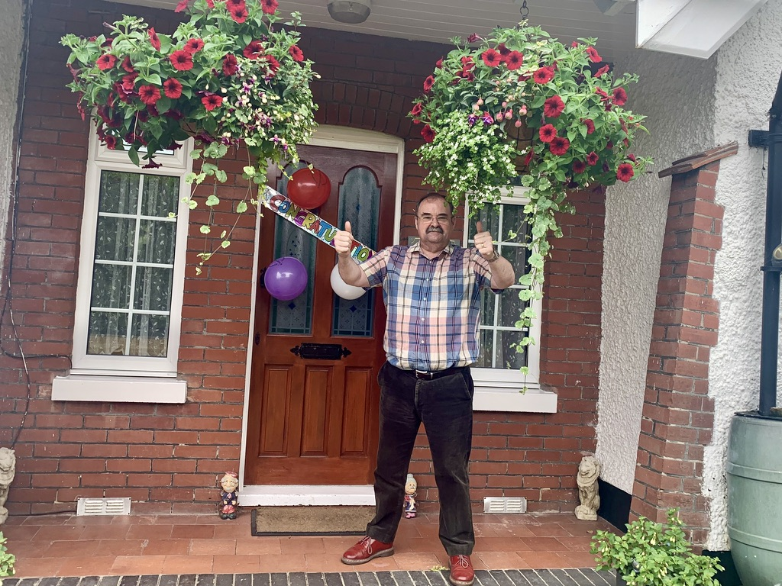
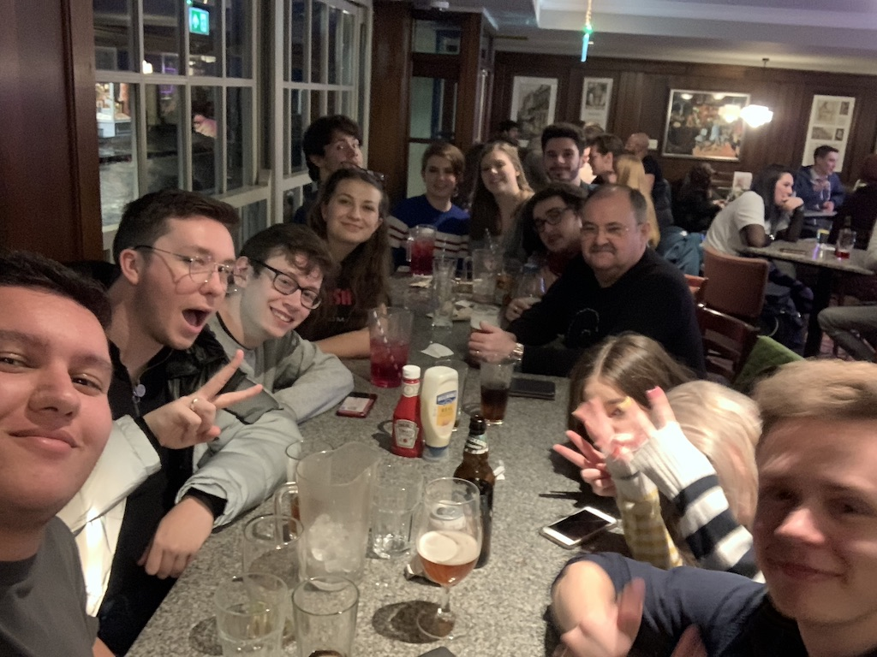
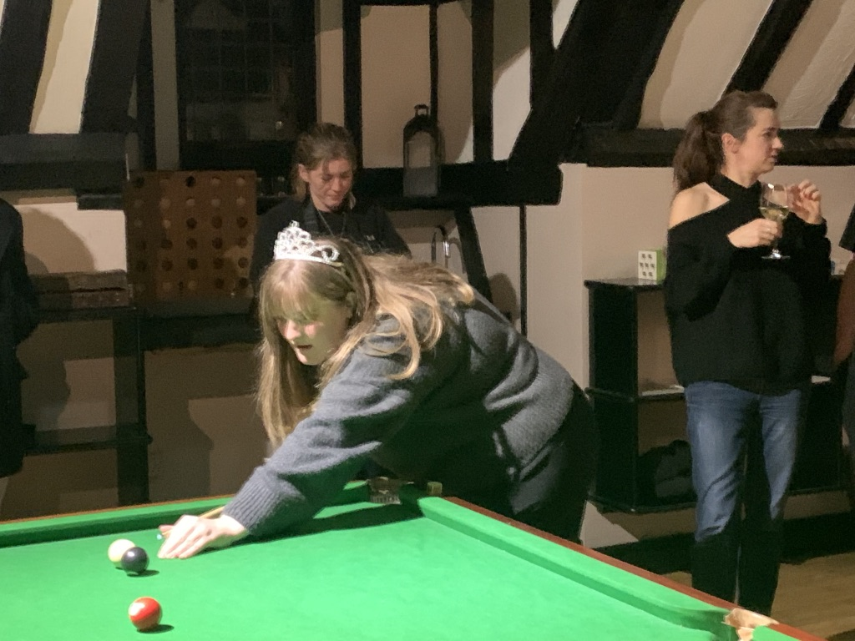
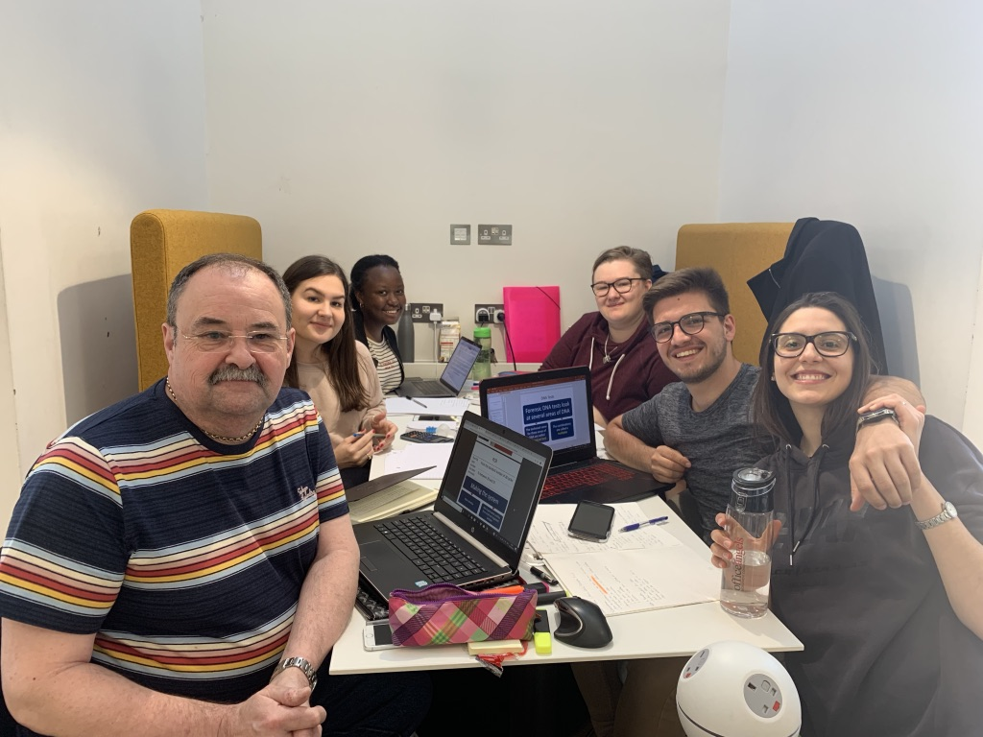
Make it enjoyable
Organise weekend trips
Use our contacts
Conference
Arrange speakers
Help with jobs
Take time to get to know them
Letters of introduction
Accessible
University can seem a long slog so
Office ‘hour’ – vs WhatsApp contact?

Slide 6
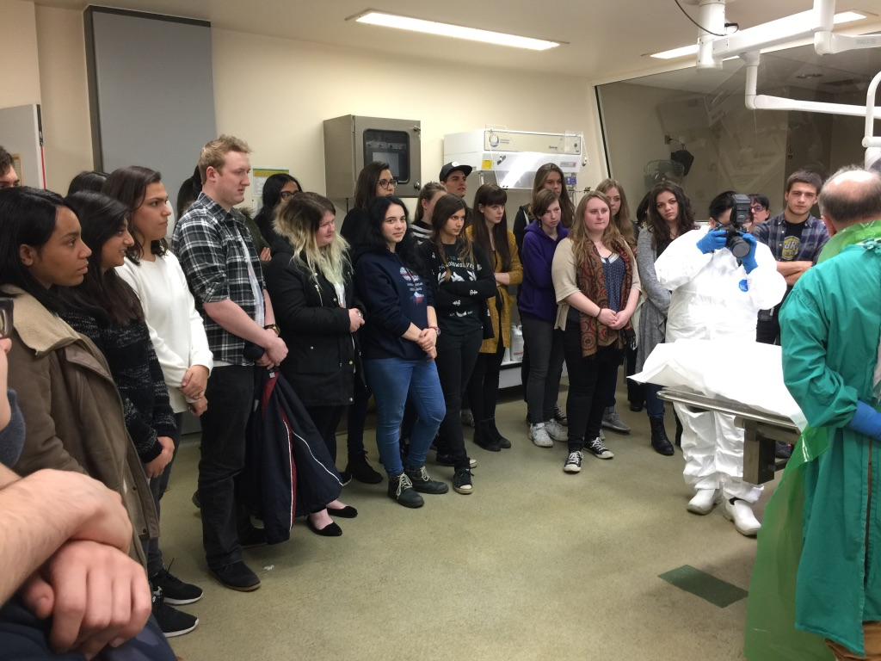
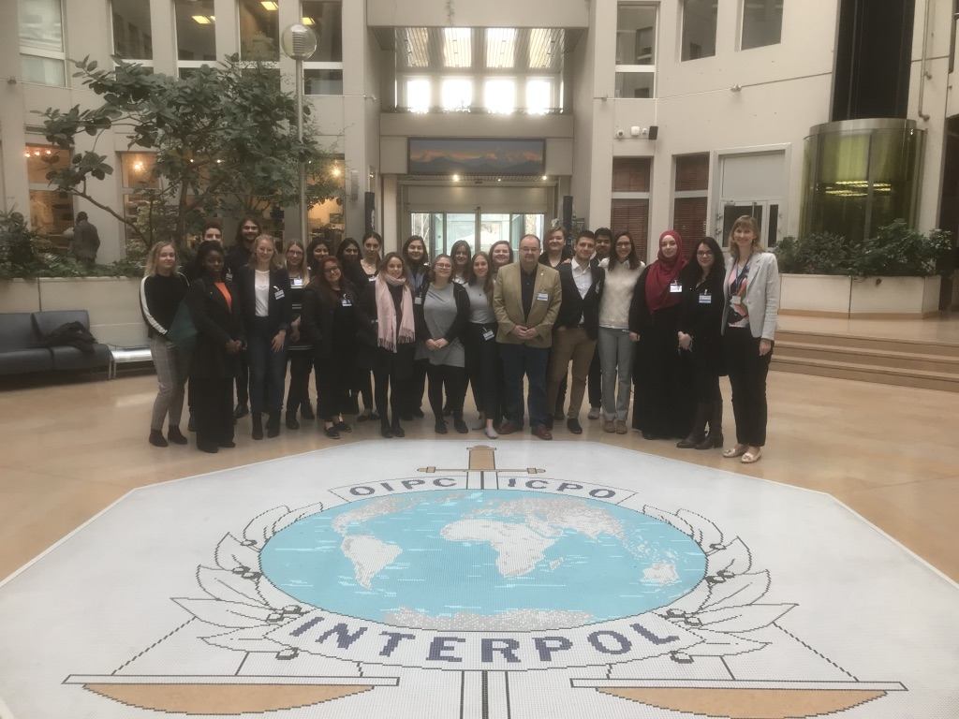
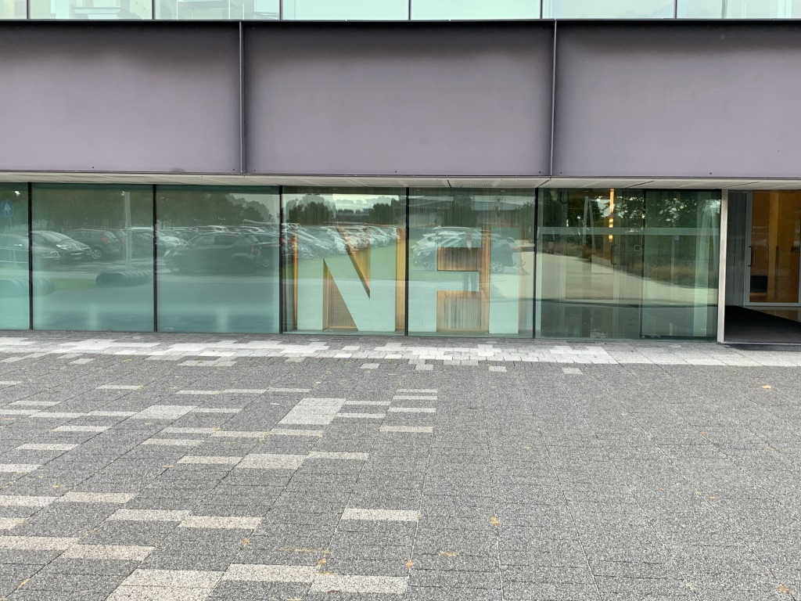
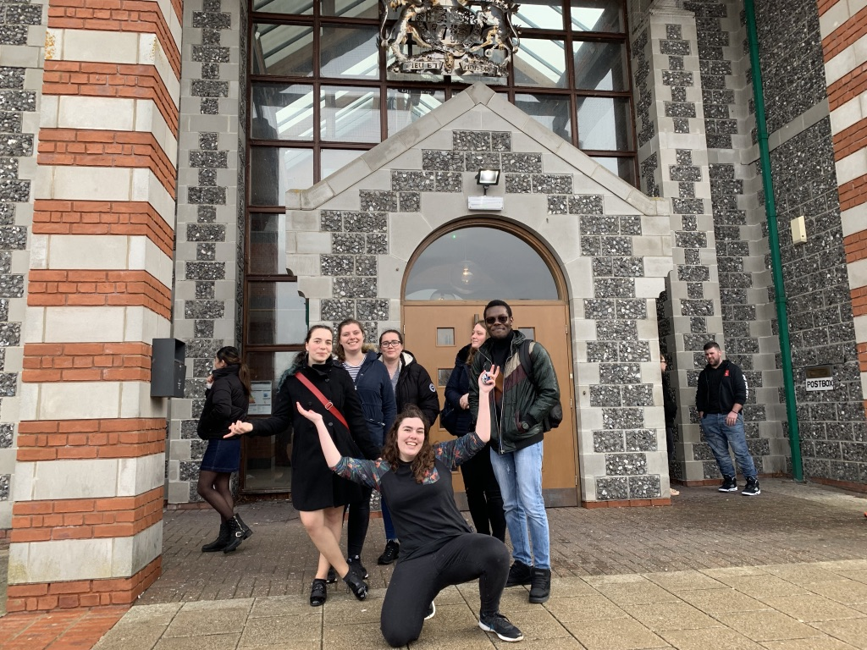
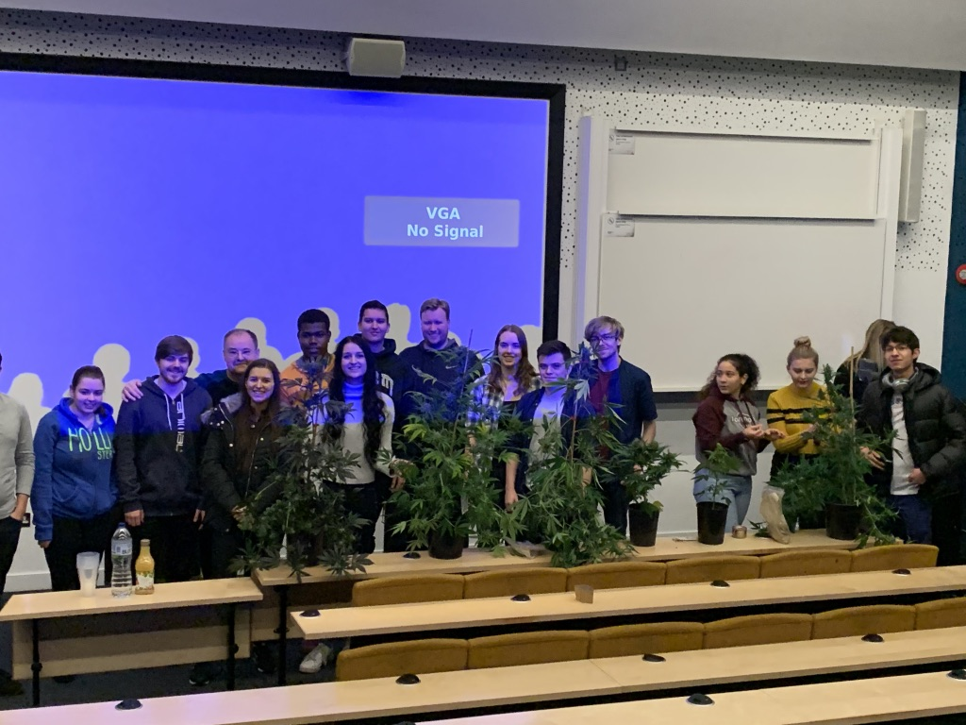
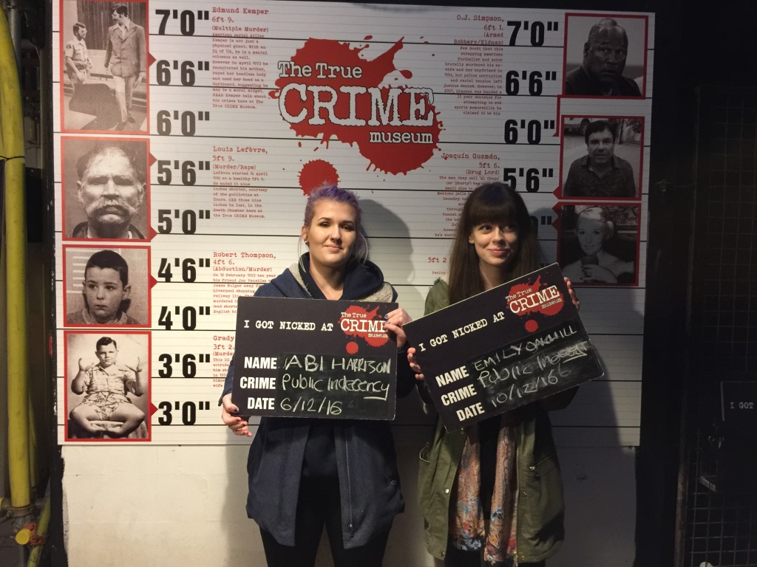
Students society
Owned by the students (first and foremost)
They need our support to help them succeed.
Get involved and help
Regular weekly events/talks/visits
One or two flagship events each year
Use your contacts to help set up events
Key to building the community

Slide 7
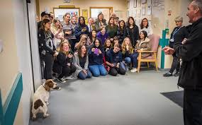
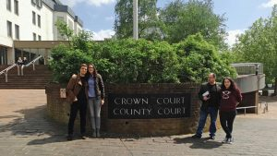
Students society
Active social media page (look at their photos here)
Get involved with them REALLY – it helps to get to know them as individuals

Slide 8
Jobs
Daily alert set for jobs specifically in forensic science.
My first job of the day/last job at night to check these
Shared in a number of ways (FB page[a] & Chat Group[b])
Several student success this way “… omg thank you so much! I am definitely going to apply for this”.
Indeed
Forensic Jobs.com
Jobs Rapido
Chartered Society of Forensic Sciences
LinkedIn Job Alerts
Reed
Word of mouth from our alumni and friends working in organisations
Some examples of sources
Chat Group – jobs posted quickly (short deadlines)

Slide 9
Keeping us ‘current’
Set up our Forensic Science Facebook Page (> 8years) with 2,530 followers
Please look, like and follow (Link here)
Youll see – I post in the last few weeks alone……..
Jobs (as soon as I see them)
Latest policy
Latest research (as soon as I spot)
Standards
Professional topics
Podcasts & other media
University news
Upcoming events
Short video files (look at the AK47)
News of upcoming webinars
Free on-line materials
Latest from CSOFS
Employability news
Items from UK & world press
Quizzes
Regulators Guidance & codes
Student awards & success
Virtual resources (comparison microscope - see)

Slide 10
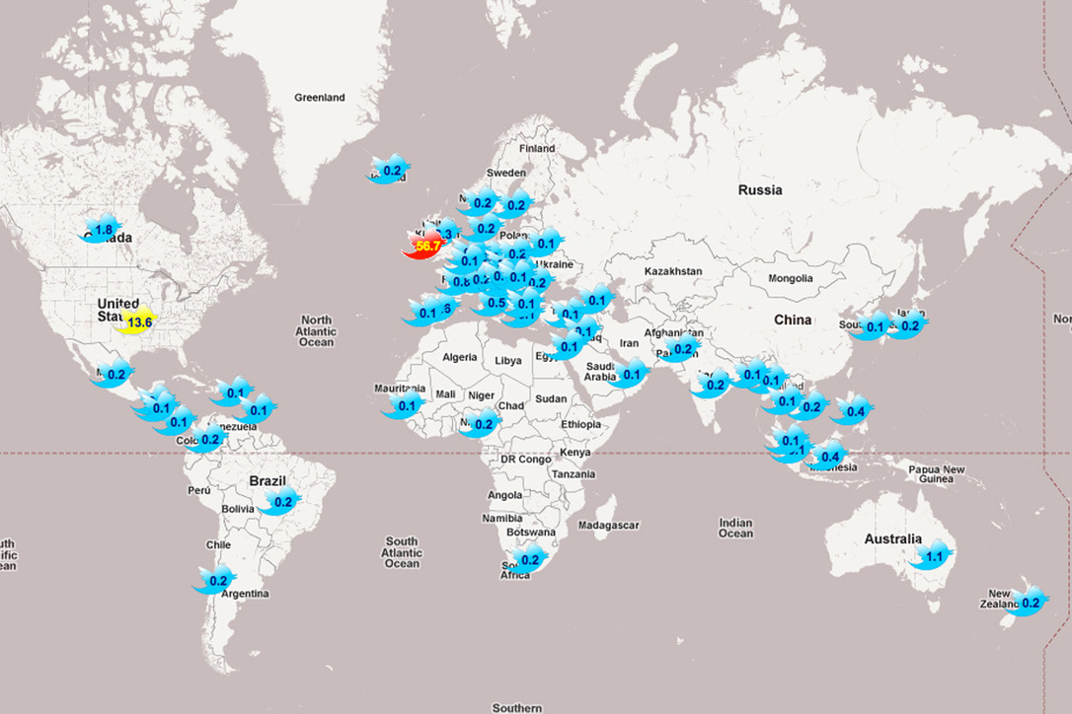
Exploit Twitter
You will pick up a significant amount of professional news from a well-established Twitter account
I set this up about seven years ago and use this to share news more widely. We now have over 2,300 followers, increasing at the rate of around 10 per week.
Benefits by keeping us current, sharing our news and expanding our digital footprint (@kentForensic)
Check on Tweepsmap or similar.
Use the information to keep the programme
up to date with the latest news from the
professional dialogue

Slide 11
Some sources of news
Perhaps begin with Google News Alerts (here)
I have keywords of – forensic, police, law, crime scene but maybe experiment with your own (not exhaustive)
Daily alerts from the Judiciary (here) with latest on legislation etc. International Symposium on Human Identification (here) Forensic Regulator news-feed (here) NIST (here) | Daily newsletter - forensicmag.com (here) Academia.edu – regular source of ‘tailored’ academic research (here) Newsletter@crime-scene-investigator. net (here) Apple users – set up the news channel?

Slide 12
Curriculum fit
I visit forensic science suppliers and spend time with them going through our programme of study.
Aimed at ensuring that we are informed by those in the profession and can produce students based upon their identified needs. Having many friends and colleagues in the profession enables me to keep close to the current practices.
For example, parts of our forensic science program now include quality standards and standard operating procedures used by those in the profession.
Feedback from employers is that this is a key benefit to them and additionally they can see how committed we are to maintain contact with them.

Slide 13
Resources
Over the years I’ve gathered together a number of academic and professional resources. Some of these can be seen here and hope they are of interest
General forensic resources
Forensic
E-Books
NIJ
Resources
Fibres
Resources
Entomology
Resources
Biochemistry
Resources
Fingerprint
Sourcebook
ENFSI
Guidelines
There may be something of interest in here

Slide 14
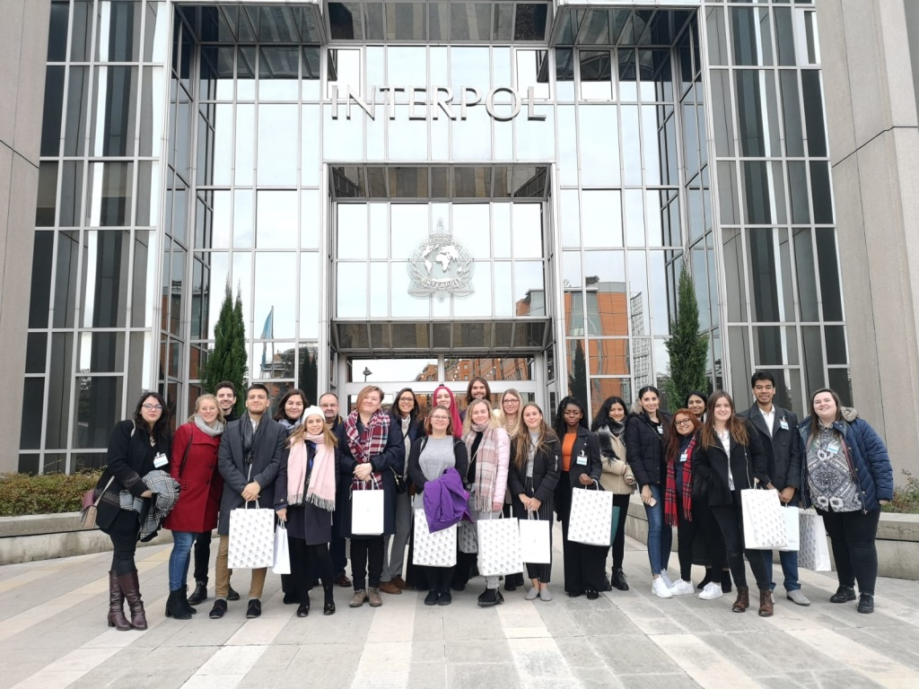
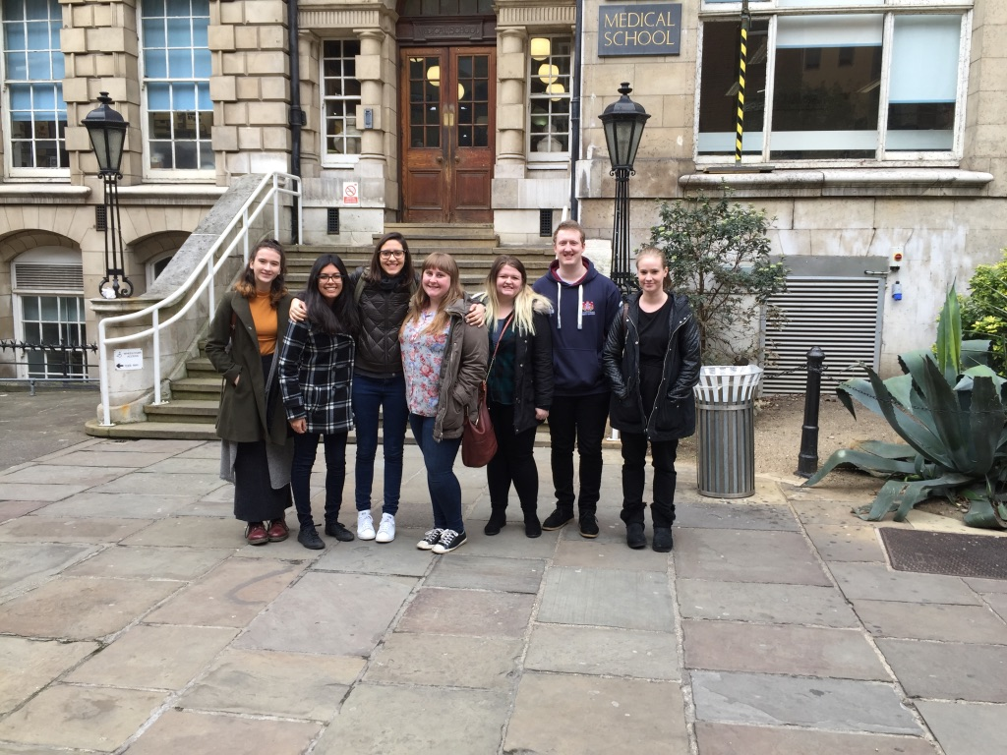
Hope that some of this has been of interest
Hope youll like and follow our FB (here)
You can take a virtual tour of our campus (here)
WhatsApp me - 07595920063
Best wishes and thank you for inviting me to speak with you.
Bob
r.green@kent.ac.uk

