Slide 1
Crime Scene Examination Using 360 & 2D Images
Tim JAMES: Senior Lecturer Crime Scene Science
tim.james@tees.ac.uk

Slide 2
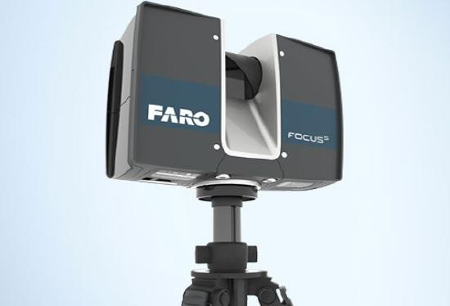
High Expectations - FARO
Initial thoughts of utilising FARO scanner
Stored at a different location – research tool
Have to book it – transport and insurance - £60K piece of equipment
Using it is complex – you forget very quickly
Takes time to record a scene
Takes even longer to render a scene and need a high powered PC

Slide 3
King Edwards Square and Crime Scene House
1 day to record all the scans
4 days
Remembering how to use the software
Starting to clean up the scans
Rendering, stitching
Needed to use home ‘games’ PC as my office one was just not of a high enough spec
Wondering where to host etc.
You need to be using the equipment and software REGULARLY
https://teesside.hosted.panopto.com/Panopto/Pages/Viewer.aspx?id=94a2c69a-1ee2-47c3-94ea-acc200fe138e

Slide 4
High Expectations - FARO
Can be very high resolution
Full 360 + 3D fully flythrough the scene
Technical level very high
Time consuming
Limited access to software and physical equipment

Slide 5
Medium Expectations – Matterport + RICOH THETA V 360
Minutes to record the 360 images
Additional time for the supporting 2D images
Matterport Pro 2 Camera – £2800 – only had one
RICOH THETA V 360 only £350 – had 10 for general student use
Good quality images
Walkthrough feel
Hosted by Matterport – Pricing

Slide 6
Medium Expectations – Matterport + RICOH V 360
Stitches well inside with good edges, less well outside at times
Renders over number of hours by Matterport
RICOH THETA V 360 only £350
RICOH THETA Z1 360 only £750 – 4K 23MP resolution – Better HDR
Good quality images
Technical complexity medium
Time taken medium
Matterport Scene

Slide 7
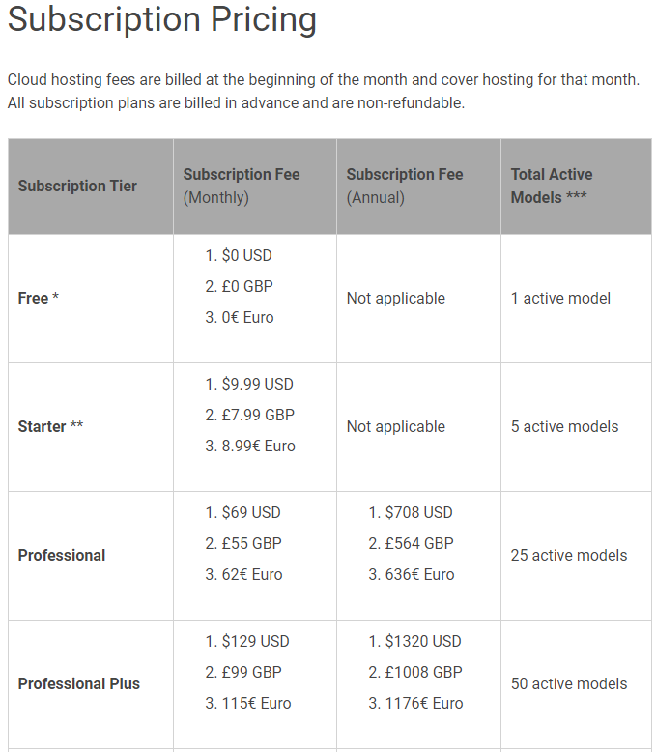
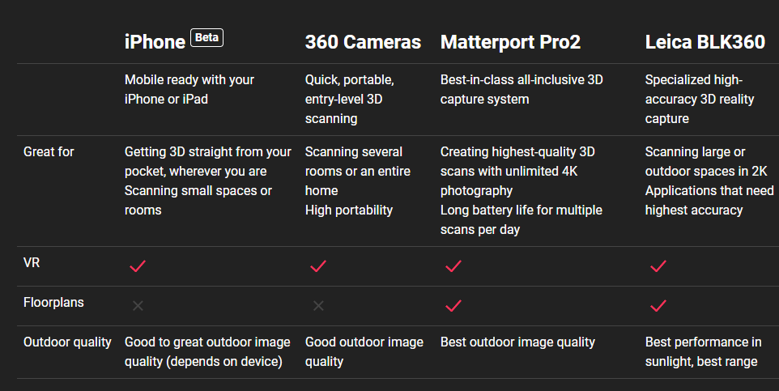
Medium Expectations – Matterport + RICOH V 360

Slide 8
Expectations Realistic / Fit For Purposes KUULA and RICOH THETA V 360
RICOH THETA V 360 only £350
Kuula Platform – good pricing structure
RICOH THETA Z1 360 only £750 – 4K 23mMp resolution – Better HDR
Good quality images
Record Scene 360 in minutes – 2D images additional time
Tour generation a couple 2 – 4 hours for basic scene

Slide 9
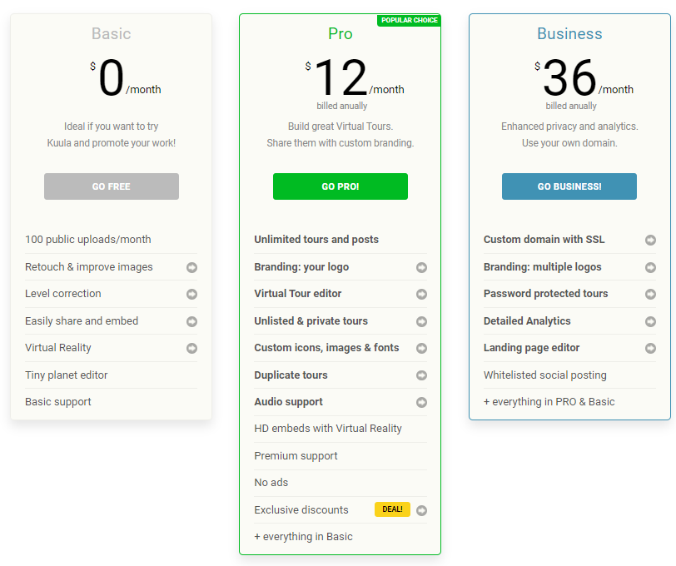

Slide 10
Learning and Teaching Applications
Pre seminar preparation – walkthrough & make notes – H&S / Digital
Walkthrough 360 with 2D scene images and examples of trace evidence and enhancements
Utilise as if student there and examining scene – decide on what exhibits could be expected to be present and recovered – provided with the 2D images – complete a CSRF
Complete statement from CSRF
Attend court and present evidence

Slide 11
Example Tours
Health and Safety Scene
Digital Scene Preparation Digital Scene with additional Images
Scene for completion of CSRF
Vehicle Scene with images, audio, questions and links out

Slide 12
Thank you for your time and attention
Any Questions?
My little initial instruction video
The tour to go with the video

