Slide 1
Teaching Forensic Science Remotely: lessons learned
Kimberlee S. Moran, MSc, RPA, ACUE
Associate Teaching Professor &
Director of Forensics
Rutgers University - Camden

Slide 2
Best Practice that works
Use your institution’s Instructional Tech office
Content delivered largely through multi-media asynchronous material; short, focused weekly synchronous session
Create excessive structure & predictability for your students
Online ≠ more assignments; use smaller varied assignments
Build accountability into online material

Slide 3
Results
Students came to every class & engaged
Students did the reading
Students turned in their assignments
Students performed better than traditional delivery

Slide 4
Forensic Science: theory & policy
Team taught with Law Professor
26 forensic students; 13 law students
Semester-end mock trial
What didn’t go well: confusion for the defense experts
What might we do differently: create examples, assign quizzes for the asynchronous material

Slide 5
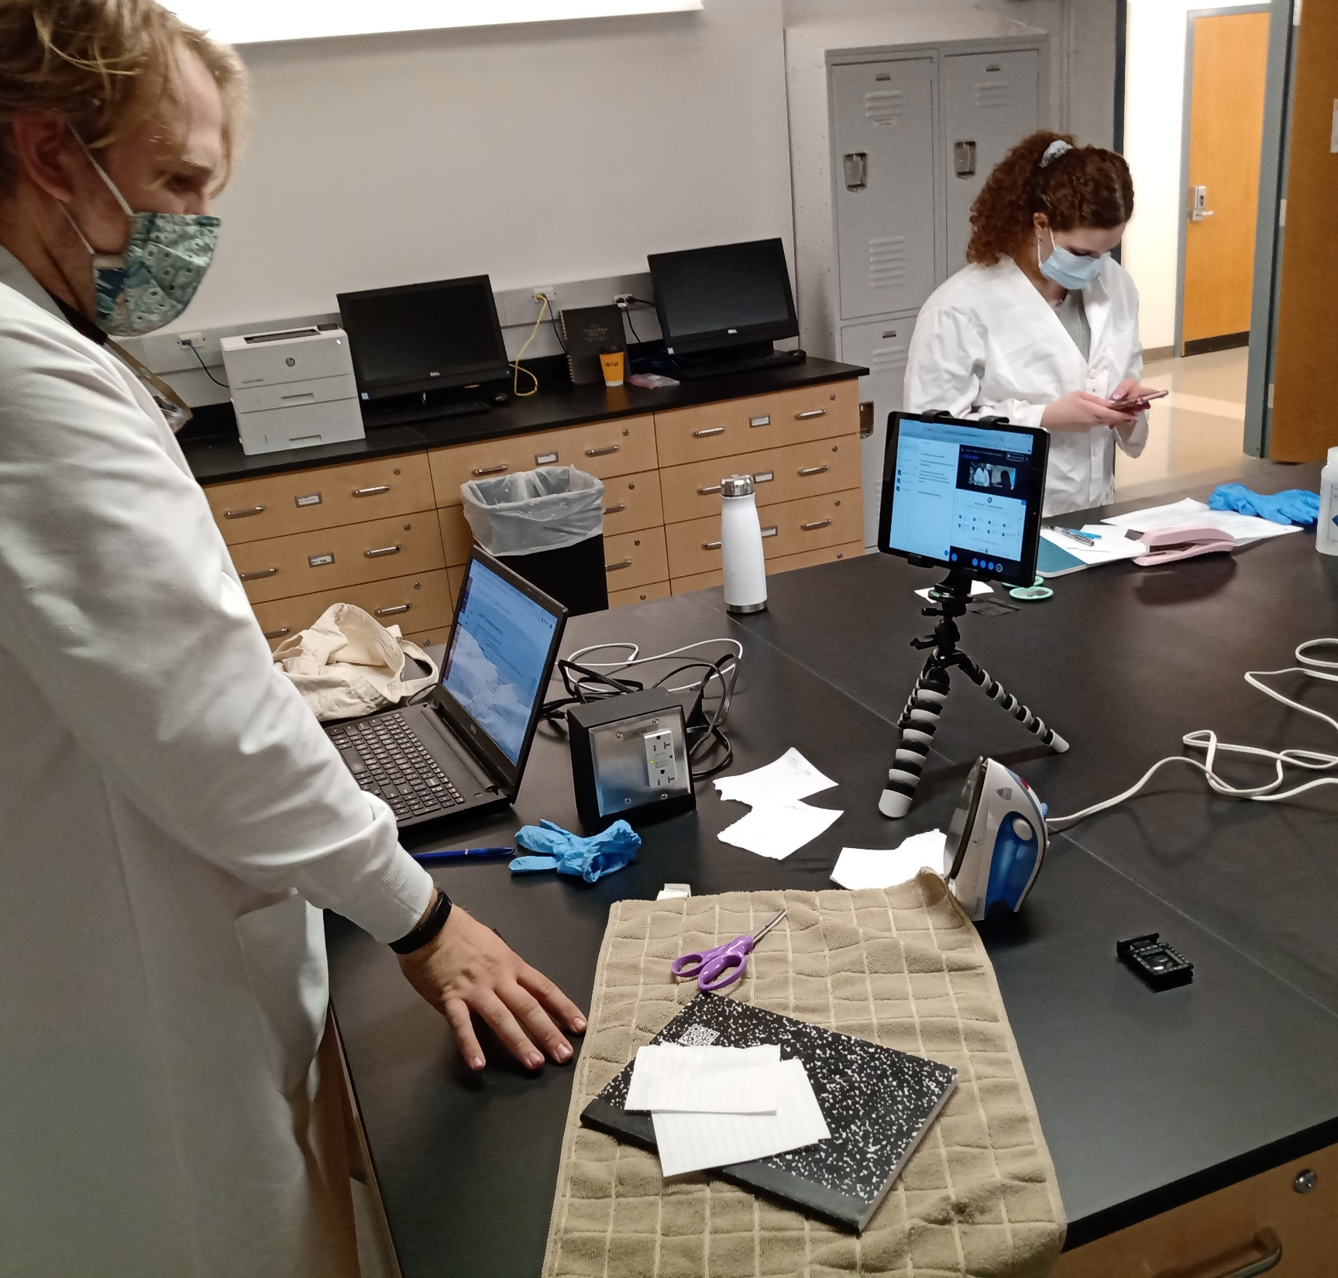
Forensic Pattern Evidence
Lab-in-a-closet/box
Used Hypothesis for readings
Used Google Drive
Virtual lab notebook
So much work!
What would I do differently: more structure

Slide 6
Forensic Science Symposium
Graduate & Professional skills course
What didn’t work: community building
What did work: “Speed-dating” networking event
What would I do differently: more breakout rooms

Slide 7
Any Questions?

