Slide 1
THE
FACULTY OF
SCIENCE
www.strath.ac.uk/science

Slide 2
Research Projects in a Pandemic
Dr Felicity Carlysle-Davies
@fcarlysle @strathforensics

Slide 3
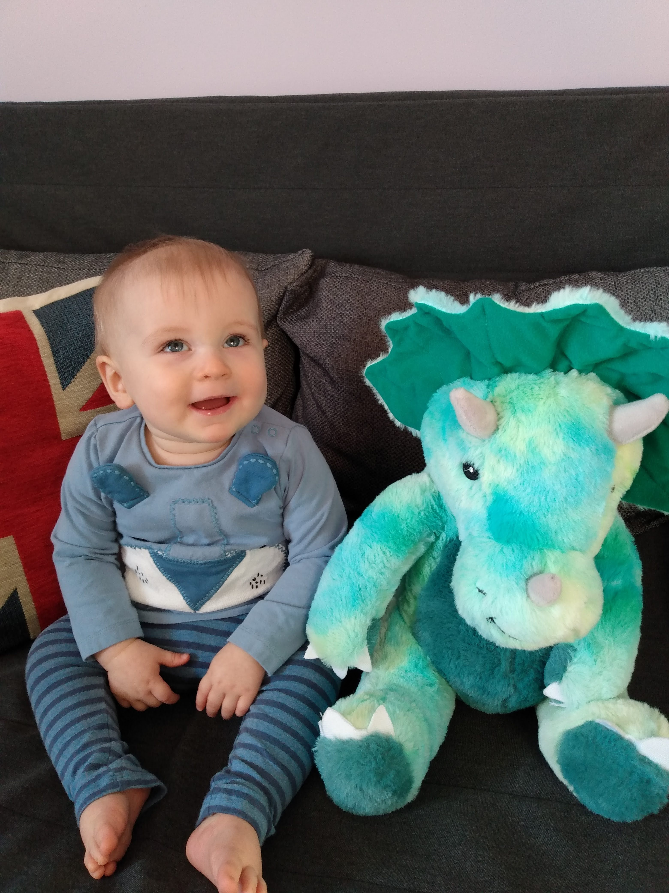
Background
Strathclyde since 2017
Project module coordinator since 2018

Slide 4
Background
MSc Forensic Science – 3 month research project
Mixture of in house and externally based projects (approx. 1/3 external)
Cohort of 50+ students

Slide 5
19/20 Academic Year
Project allocation process already underway
Students already had accepted external project placements
Staff had already drafted internal project proposals
Initial dialogue was with project providers about a possible delay to the start of lab work
Quickly became clear that students were not going to be able to attend in person or carry out practical lab work
This Photo by Unknown Author is licensed under CC BY-SA

Slide 6
Pandemic projects
Where possible students who had external projects were kept with their external provider – moving to a non-lab based project
Staff drafted new literature based project proposals
The Leverhulme Research Centre for Forensic Science offered to take an increased number of students for data based projects
Thank you!!

Slide 7
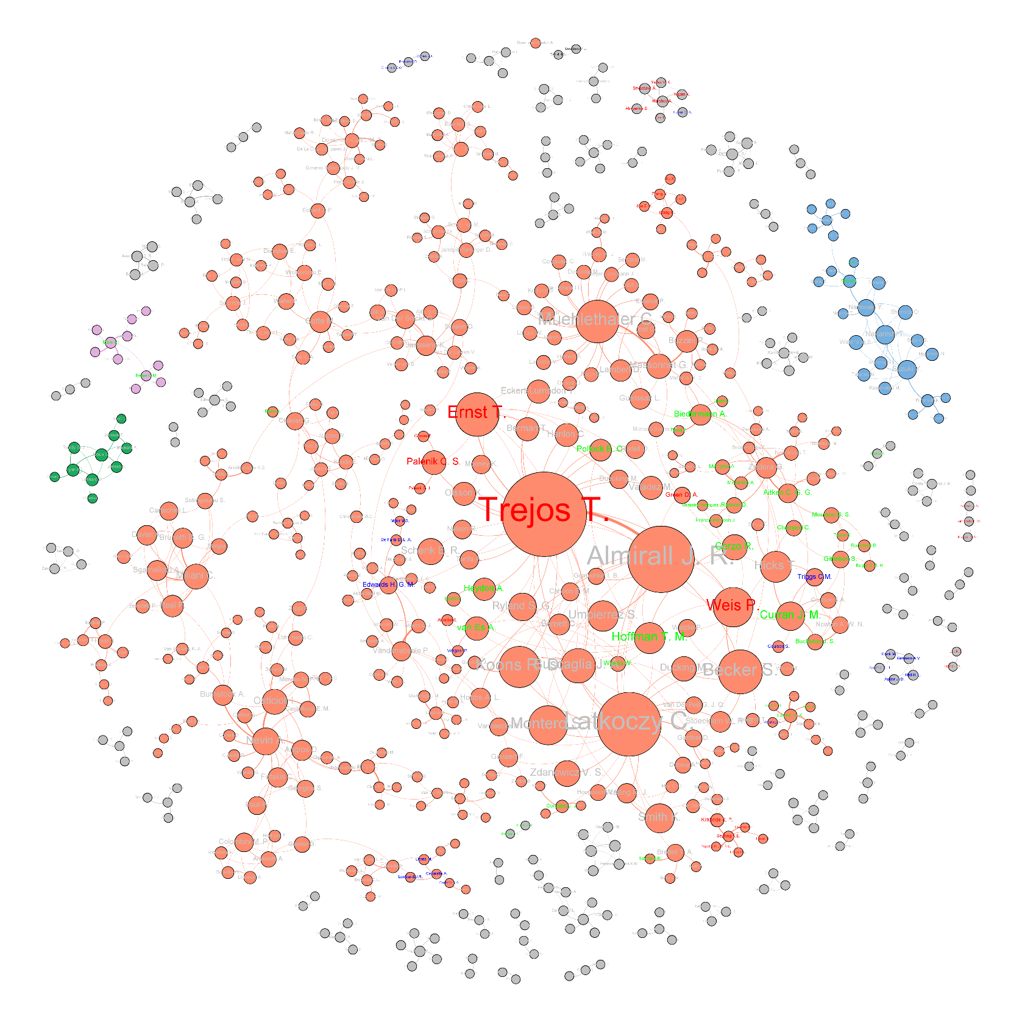
Pandemic projects - Leverhulme
Scientometric studies of different aspects of forensic science research
Students learnt about coding using R
Students learnt about new ways to interpret and present data – Gephi & R Studio

Slide 8
Pandemic projects – other ways to get data
External provider runs samples and passes on the data
Use of surveys
Notes:
Issue with being dependent on them having sufficient time etc – might have been better if the data already existed rather than being generated new
Surveys – just have to remember the ethics side of things

Slide 9
Pandemic projects – literature based
Missing the data handling element – we have a separate literature project mark scheme
Allowed staff to offer projects on a far wider range of topics than we can do for practical projects
Students had the chance to steer the direction of their project – bit of a double-edged sword!
Notes:
General feeling was that marking literature based projects was far harder than data based projects – more subjectivity!

Slide 10
What we learnt?
It is still possible to successfully run projects!
Increased student support is welcomed and appreciated
Students understand that it is a difficult situation – keep communication as clear as possible
It is hard to have a one size fits all marking scheme – data based projects make the marking easier
Students still learn plenty of skills even if they aren’t in the lab!
Notes:
Weekly meetings and support from PDAs as well as supervisors

Slide 11
Looking forward
Trying to be as honest and open with students
Still working with external providers
Introducing project presentations – can be done online
Try to ensure all projects have some aspect of data handling/analysis
Looking at possible training in using R or Matlab
Ways to generate data:
Using existing sources
Student cohort responses – lots of things can be done online
External provider generated data
Surveys
Don’t panic!
This Photo by Unknown Author is licensed under CC BY-NC
Notes:
Not just covid we also have Brexit implications to contend with
Discuss options with them. Presentations allow students to demonstrate a skill that can then be included in their skills matrix
Lance Corporal Jones – don’t panic

Slide 12
Questions?

